Slide 1

Continual Learning:
The State of the Art?
Riccardo Volpi
riccardo.volpi@naverlabs.com
3 May 2022
University of Trento

Slide 2
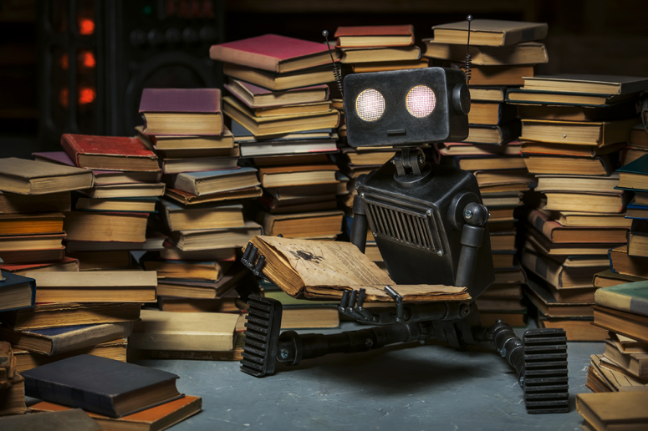
Our plan for today
Moving on from the “standard” learning paradigm.
The continual learning formulation
Incremental learning
Streaming/online learning
Learning new domains vs learning new classes/tasks
Continual learning benchmarks
Continual learning methods
Regularization methods
Memory-based methods
Architecture growing methods
Online unsupervised domain adaptation
Continual learning @ Naver Labs Europe
(image from Shutterstock)
2

Slide 3
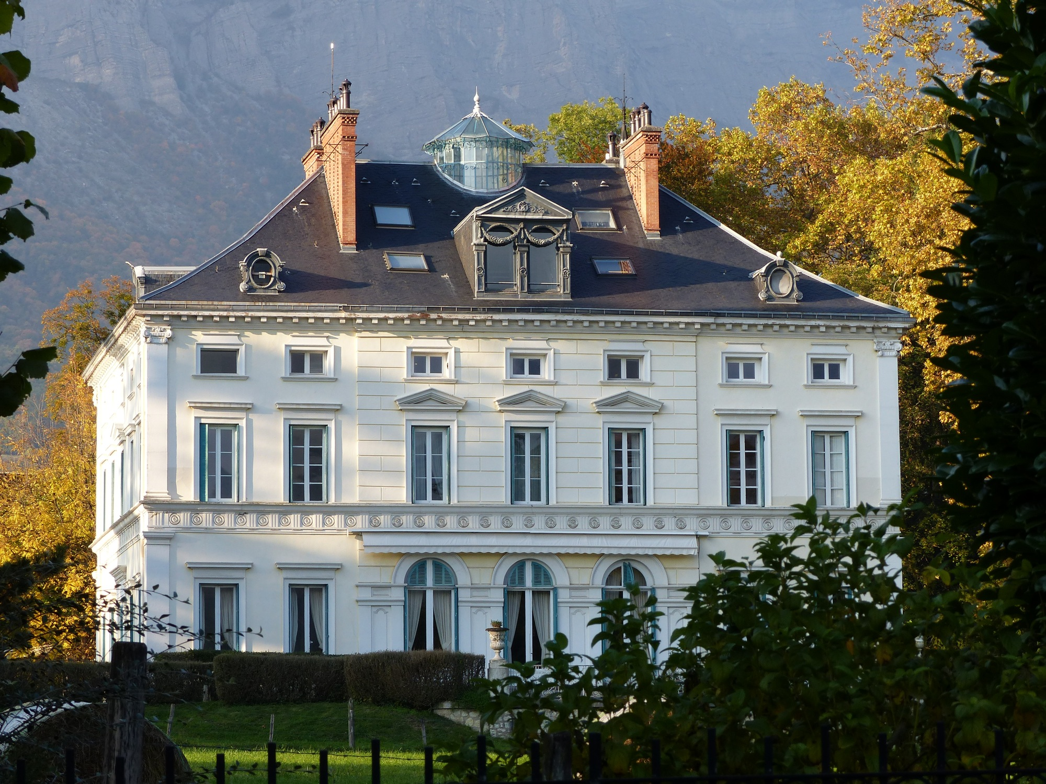
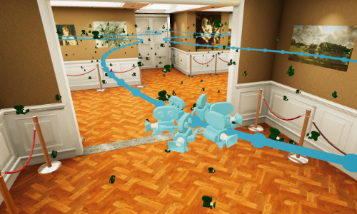
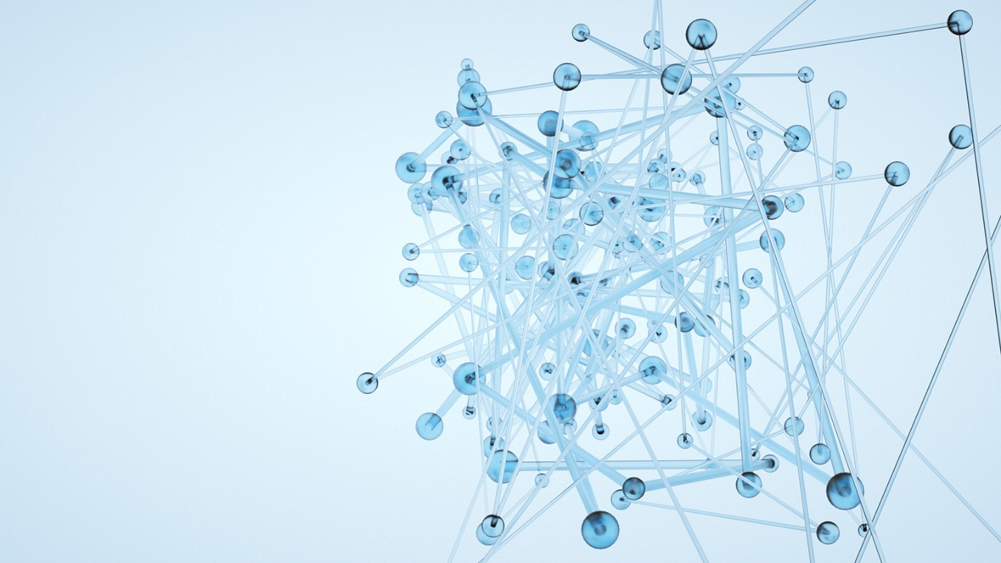
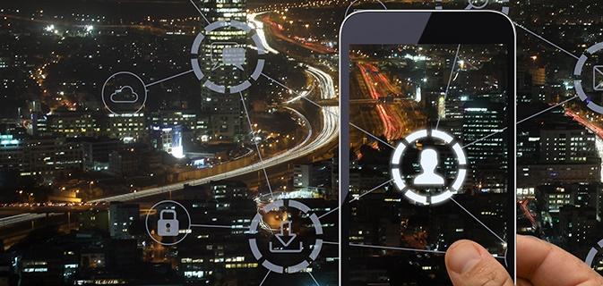
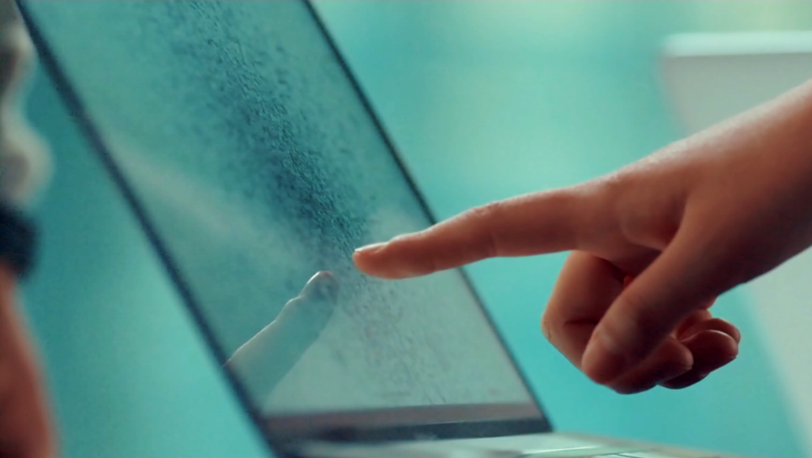
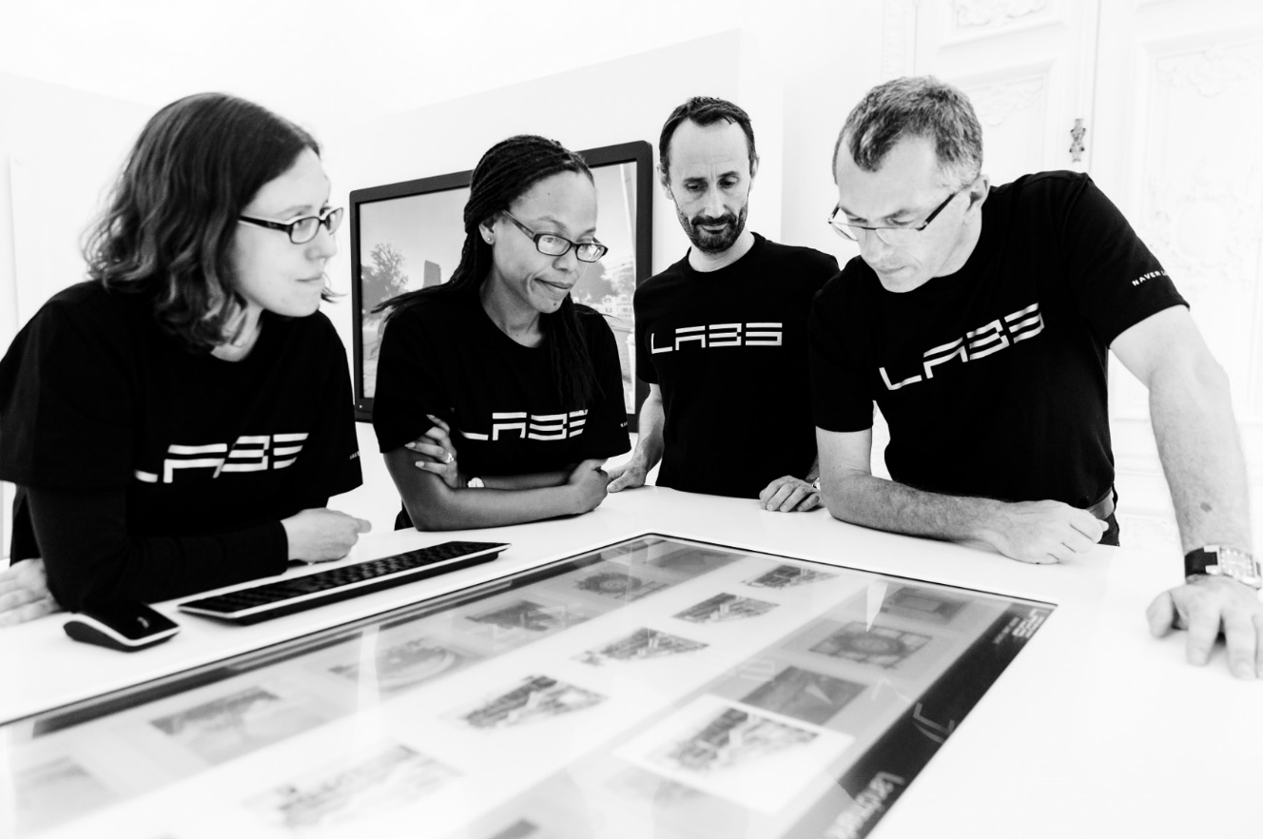
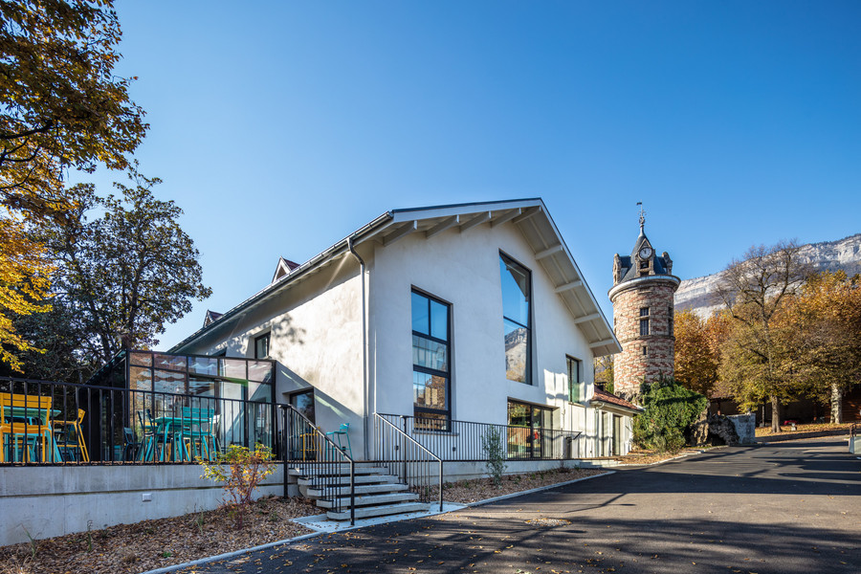
Naver Labs Europe
Computer
Vision
3D Vision
Machine Learning
& Optimization
Year-round internships!
(image from Shutterstock)
Search &
Recommendation
Natural
Language
Processing
UX &
Ethnography
3

Slide 4
The “standard” supervised learning paradigm

Slide 5
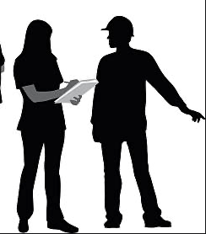
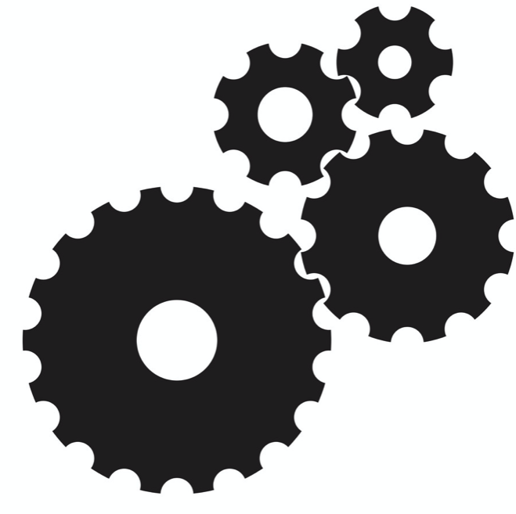

The “standard” supervised learning paradigm
A revolution happened by switching from hand-crafted to data-driven solutions
Hand-crafted features
Learned features
samples
samples
+
predictions
predictions

Slide 6

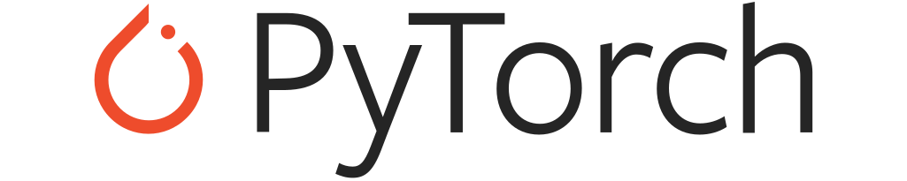
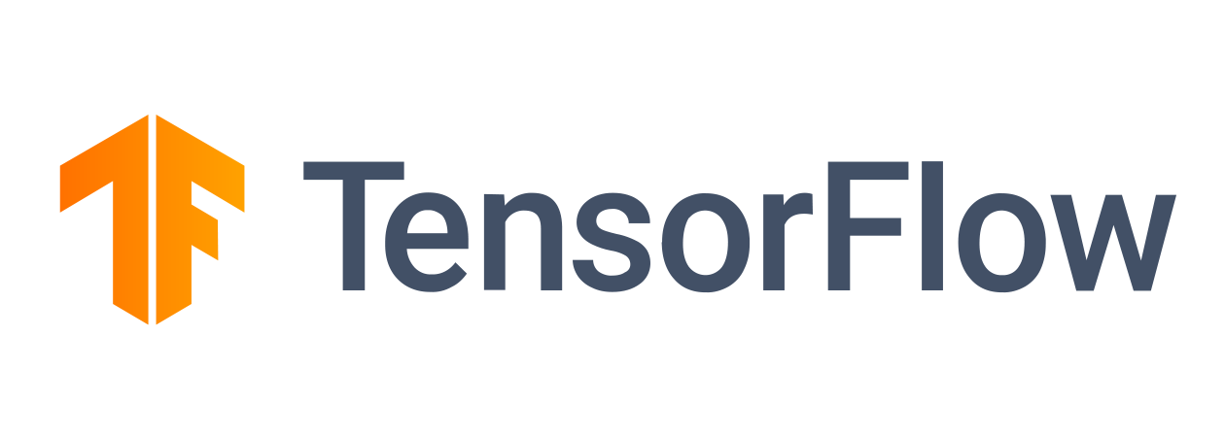
The “standard” supervised learning paradigm
A revolution happened by switching from hand-crafted to data-driven solutions
(your favorite neural net)
+

Slide 7
The “standard” supervised learning paradigm
A revolution happened by switching from hand-crafted to data-driven solutions
Typical ingredients
Huge data availability (often labeled)
+
Time and computational resources
Offline training / seeing each sample again and again
(your favorite neural net)
Assumption of an iid world

Slide 8
The self-supervised learning paradigm
A revolution happened by switching from hand-crafted to data-driven solutions
Typical ingredients
Huge data availability (unlabeled) (often labeled)
+
Time and computational resources
Offline training / seeing each sample again and again
(your favorite neural net)
Assumption of an iid world

Slide 9
A parallel with human learning
In contrast, humans learn continuously by processing streams of samples.
We are very good few-shot learners, and can generalize to unfamiliar conditions.
We do extensive unsupervised learning.
In short, we don’t learn visual categories by staring again and again at annotated photos.
Note: I’m not assuming we can replicate human intelligence with the models we are currently using, but we need to apprehend some of these capabilities, very important e.g. in robotics.

Slide 10
Simple continual learning examples
…what can (and will) go wrong.

Slide 11
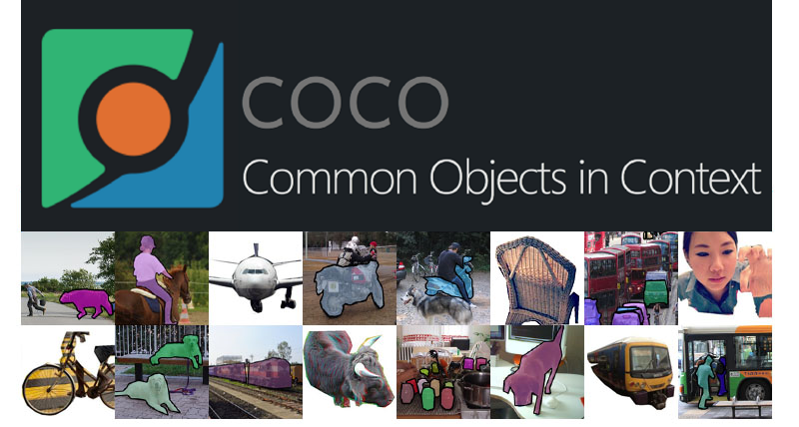
Simple continual learning examples
…what can (and will) go wrong.
?
Model
Model

Slide 12
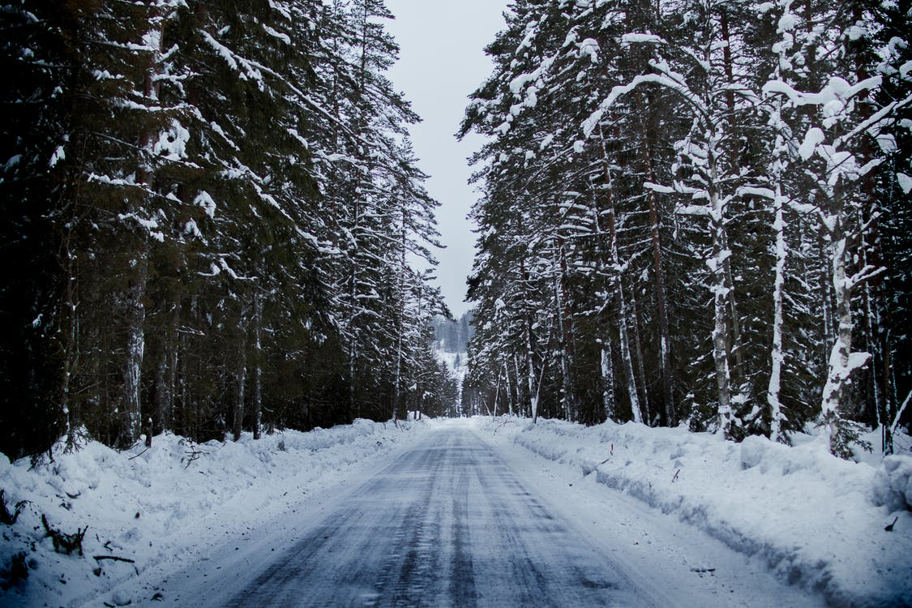
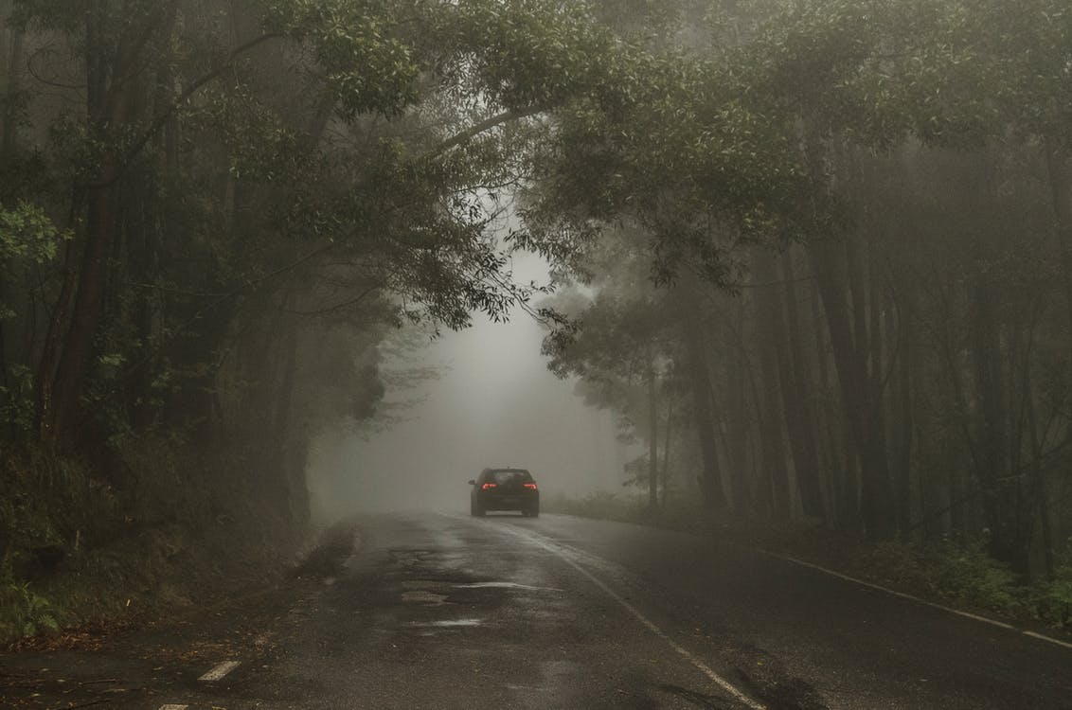
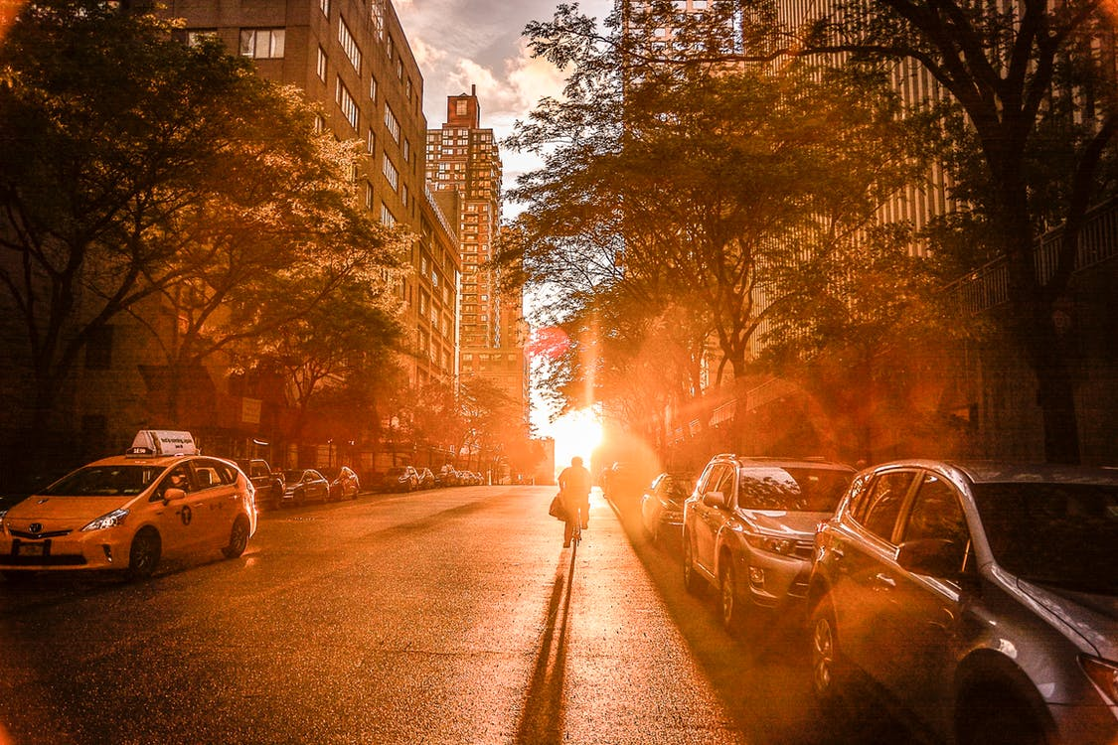
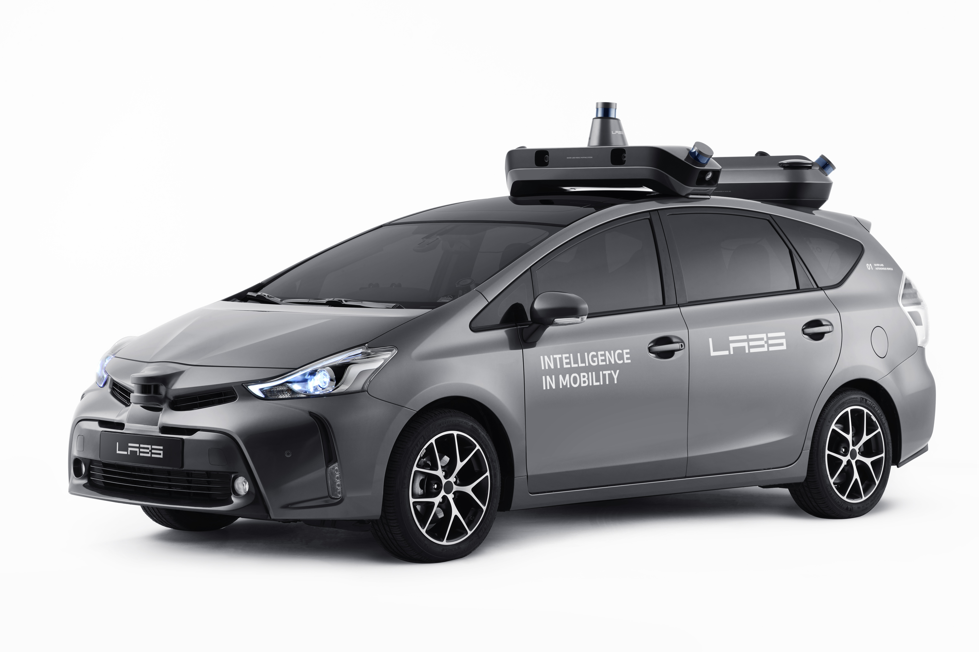
Simple continual learning examples
Model
Model
Model
?
?
Catastrophic forgetting: models will forget
previously learned patterns and tasks.

Slide 13
Continual Learning Formulations

Slide 14
Incremental batch learning

Slide 15
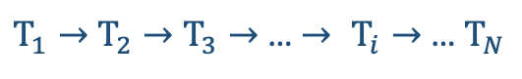
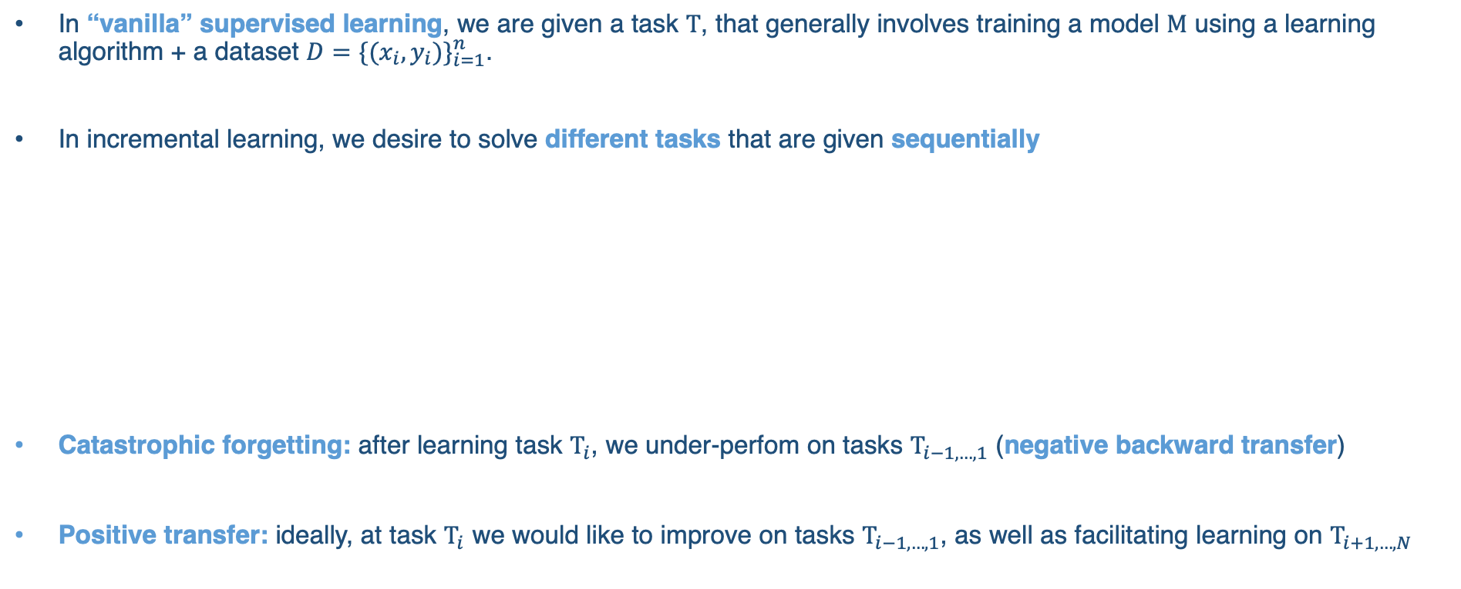
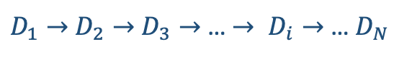
Incremental batch learning
In “vanilla” supervised learning, we are given a task $Τ$, that generally involves training a model $Μ$ using a learning algorithm + a dataset ${D=\{(x_{i},y_{i})\}}_{i=1}^{n}$.
In incremental learning, we desire to solve different tasks that are given sequentially
Catastrophic forgetting: after learning task $Τ_{i}$, we under-perfom on tasks $Τ_{i−1,…,1}$ (negative backward transfer)
Positive transfer: ideally, at task $Τ_{i}$ we would like to improve on tasks $Τ_{i−1,…,1}$, as well as facilitating learning on $Τ_{i+1,…,N}$
$Τ_{1}→$ $Τ_{2}→$ $Τ_{3}→$… $→ Τ_{i}→$ … $Τ_{N}$
with the associated datasets
$D_{1}→$ $D_{2}→$ $D_{3}→$… $→ D_{i}→$ … $D_{N}$

Slide 16
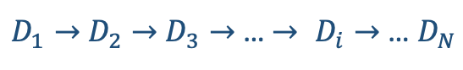
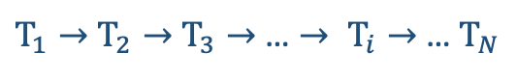
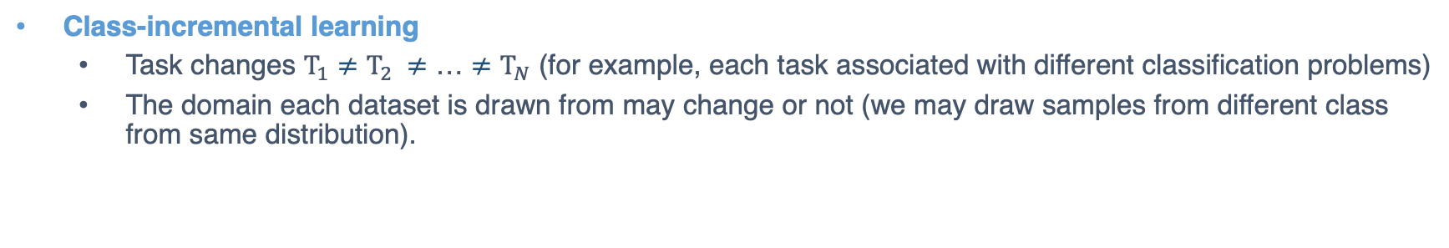
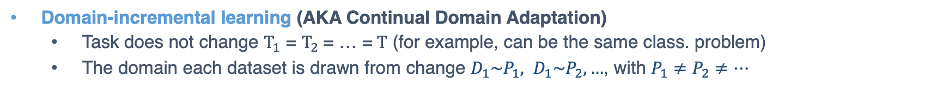
Incremental batch learning
What is a “task”?
Two main incremental learning problems in the literature:
Domain-incremental learning
Class-incremental learning
$Τ_{1}→$ $Τ_{2}→$ $Τ_{3}→$… $→ Τ_{i}→$ … $Τ_{N}$
with the associated datasets
$D_{1}→$ $D_{2}→$ $D_{3}→$… $→ D_{i}→$ … $D_{N}$
Domain-incremental learning (AKA Continual Domain Adaptation)
Task does not change $Τ_{1}$ = $Τ_{2}$= … =$Τ$ (for example, can be the same class. problem)
The domain each dataset is drawn from change $D_{1}\sim P_{1}, D_{1}\sim P_{2}, …$, with $P_{1}≠P_{2}≠…$
Class-incremental learning
Task changes $Τ_{1}$ $≠$ $Τ_{2} ≠$ … $≠Τ_{N}$ (for example, each task associated with different classification problems)
The domain each dataset is drawn from may change or not (we may draw samples from different class from same distribution).
“Task label”: at deployment, we should avoid relying on information re: the specific task samples come from.

Slide 17
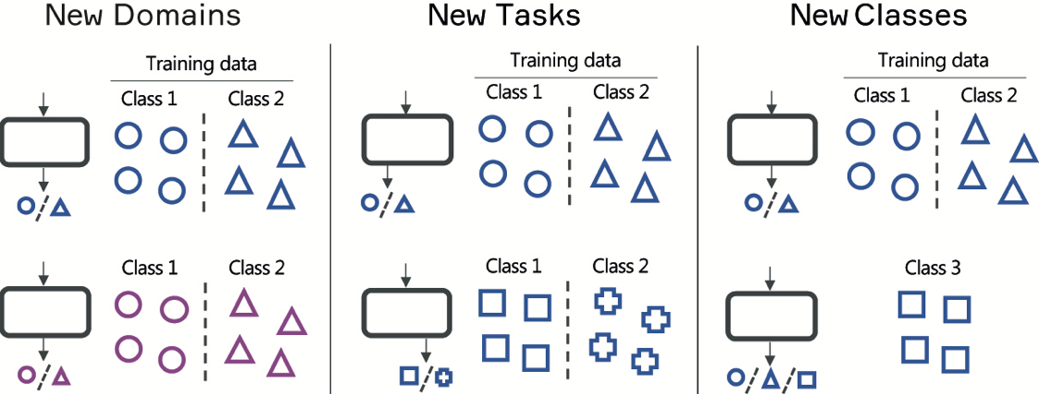
Incremental batch learning

Slide 18
Streaming/online learning

Slide 19
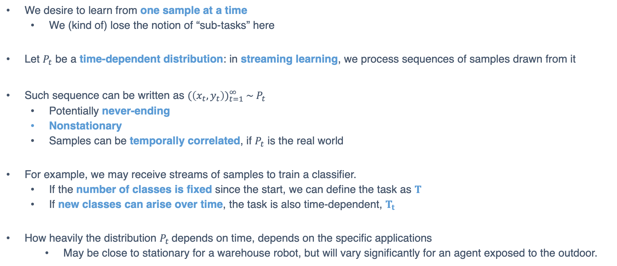
Streaming/online learning
We desire to learn from one sample at a time
We (kind of) lose the notion of “sub-tasks” here
Let $P_{t}$ be a time-dependent distribution: in streaming learning, we process sequences of samples drawn from it
Such sequence can be written as ${(\left(x_{t},y_{t}\right))}_{t=1}^{∞} {\sim P}_{t}$
Potentially never-ending
Nonstationary
Samples can be temporally correlated, if $P_{t}$ is the real world
For example, we may receive streams of samples to train a classifier.
If the number of classes is fixed since the start, we can define the task as $Τ$
If new classes can arise over time, the task is also time-dependent, $Τ_{t}$
How heavily the distribution $P_{t}$depends on time, depends on the specific applications
May be close to stationary for a warehouse robot, but will vary significantly for an agent exposed to the outdoor.

Slide 20
Continual Learning Benchmarks

Slide 21
Examples of benchmarks
Incremental batch learning
Streaming learning
ImageNet: divide ImageNet in ten different tasks, with ten label sets. See each sample once.
MNIST (domain): learning from ten different versions of MNIST where pixels are randomly permuted.
MNIST (class): divide MNIST in ten different tasks, with ten different label sets.
CIFAR-10/100: divide CIFAR-10/100 in ten different tasks, with ten different label sets.
ImageNet: divide ImageNet in ten different tasks, with ten different label sets.
iCubWorld
CoRE-50
Stream-51

Slide 22
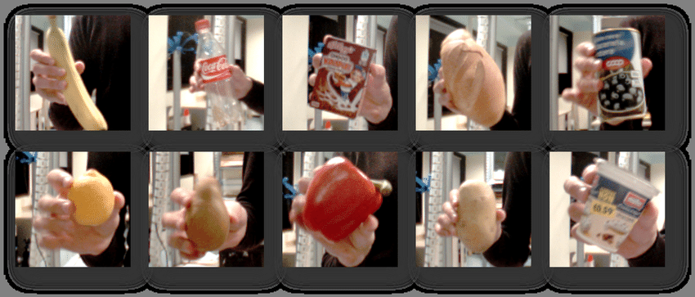
Examples of benchmarks
Incremental batch learning
Streaming learning
ImageNet: divide ImageNet in ten different tasks, with ten label sets. See each sample once.
MNIST (domain): learning from ten different versions of MNIST where pixels are randomly permuted.
MNIST (class): divide MNIST in ten different tasks, with ten different label sets.
CIFAR-10/100: divide CIFAR-10/100 in ten different tasks, with ten different label sets.
ImageNet: divide ImageNet in ten different tasks, with ten different label sets.
iCubWorld
CoRE-50
Stream-51
[Pasquale et al., JMLR 2015]

Slide 23
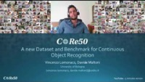
Examples of benchmarks
Incremental batch learning
Streaming learning
ImageNet: divide ImageNet in ten different tasks, with ten label sets. See each sample once.
MNIST (domain): learning from ten different versions of MNIST where pixels are randomly permuted.
MNIST (class): divide MNIST in ten different tasks, with ten different label sets.
CIFAR-10/100: divide CIFAR-10/100 in ten different tasks, with ten different label sets.
ImageNet: divide ImageNet in ten different tasks, with ten different label sets.
iCubWorld
CoRE-50
Stream-51
[Lomonaco et al., CoRL 2017]

Slide 24
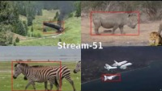
Examples of benchmarks
Incremental batch learning
Streaming learning
ImageNet: divide ImageNet in ten different tasks, with ten label sets. See each sample once.
MNIST (domain): learning from ten different versions of MNIST where pixels are randomly permuted.
MNIST (class): divide MNIST in ten different tasks, with ten different label sets.
CIFAR-10/100: divide CIFAR-10/100 in ten different tasks, with ten different label sets.
ImageNet: divide ImageNet in ten different tasks, with ten different label sets.
iCubWorld
CoRE-50
Stream-51
[Roady et al., CVPRW 2020]

Slide 25
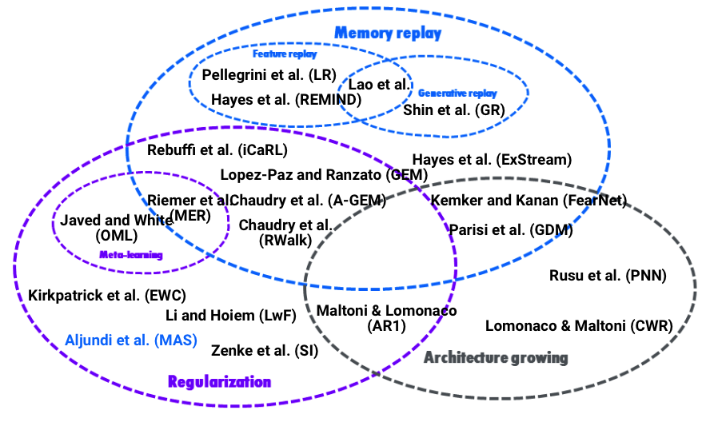
Continual learning methods
We follow Parisi et al. [1] and Maltoni and Lomonaco [2] in categorizing CL approaches.
We also wrote a more informal blog post about this, find it at this link.
Three main bodies of work
Regularization
Memory-based
Architecture growing

Slide 26
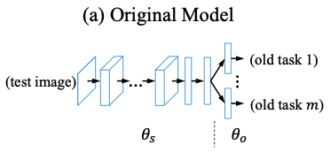
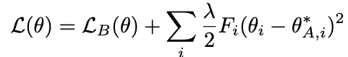
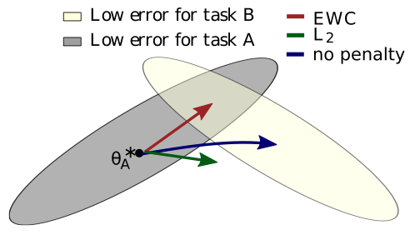
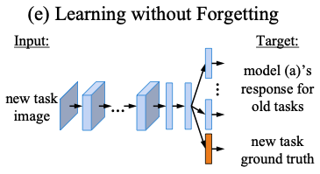
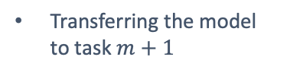
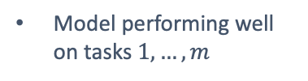
Regularization methods
Avoid catastrophic forgetting by regularizing the loss at hand (for example, the cross-entropy loss)
Pros: Principled approaches, trying to improve the objectives we optimize in deep learning.
Cons: These methods generally work well if provided with the task label.
Elastic Weight Consolidation (EWC)
Learning without Forgetting (LwF)
Moving from task A to task B
Distillation
Model performing well on tasks $1,…,m$
Transferring the model to task $m+1$
[EWC] Kirkpatrick et al., “Overcoming Catastrophic Forgetting in Deep Neural Networks”, PNAS 2017
[LwC] Li and Hoiem, “Learning without Forgetting”, ECCV 2016

Slide 27
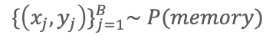
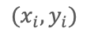
Memory-based methods
Avoid catastrophic forgetting by rehearsing old samples, stored in memory.
Pros: Best performing algorithms.
Cons: Possible memory/privacy issues. Public benchmarks are very small / mostly tested iid.
Learning whole network
Memory of images
memory
$${\{\left(x_{j},y_{j}\right)\}}_{j=1}^{B}\sim P(memory)$$
feature
extractor
logit
layer
data stream/
current task
stack
cross-entropy
loss
$$(x_{i},y_{i})$$
[iCaRl] Rebuffi et al., “iCaRl: Incremental Classifier and Representation Learning”, CVPR 2017
Chaudry et al., “On Tiny Episodic Memories in Continual Learning”, ICML Workshops 2019

Slide 28
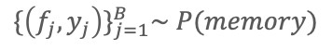
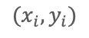
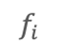
Memory-based methods
Avoid catastrophic forgetting by rehearsing old samples, stored in memory.
Pros: Best performing algorithms.
Cons: Possible memory/privacy issues. Public benchmarks are very small / mostly tested iid.
Learning final layers
Memory of features
memory
$${\{\left(f_{j},y_{j}\right)\}}_{j=1}^{B}\sim P(memory)$$
feature
extractor
logit
layer
data stream /
current task
$$(x_{i},y_{i})$$
$$f_{i}$$
stack
cross-entropy
loss
[REMIND] Hayes et al., “REMIND your Network to Prevent Catastrophic Forgetting”, ECCV 2020
Pellegrini et al., “Latent Replay for Real-time Continual Learning”, arXiv 2019

Slide 29
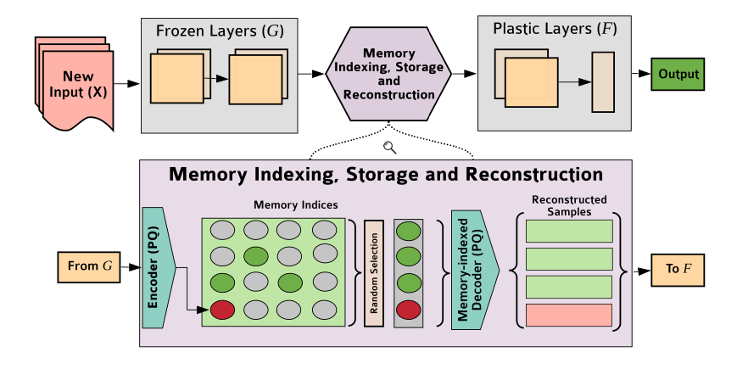
Memory-based methods
Avoid catastrophic forgetting by rehearsing old samples, stored in memory.
Pros: Best performing algorithms.
Cons: Possible memory/privacy issues. Public benchmarks are very small / mostly tested iid.
REMIND method (ECCV 2020)
PQ to compress features
Very low reconstruction error
Can store many more samples
Does not do representation learning
[REMIND] Hayes et al., “REMIND your Network to Prevent Catastrophic Forgetting”, ECCV 2020

Slide 30
Memory-based methods
Avoid catastrophic forgetting by rehearsing old samples, stored in memory.
Pros: Best performing algorithms.
Cons: Possible memory/privacy issues. Public benchmarks are very small / mostly tested iid.
My opinion:
How to select which samples to store in memory is a very interesting research direction.
Especially when focusing on ML system that receive millions/billions of samples per day.
Random/reservoir VERY strong baselines.
[REMIND] Hayes et al., “REMIND your Network to Prevent Catastrophic Forgetting”, ECCV 2020

Slide 31
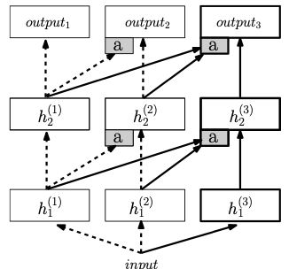
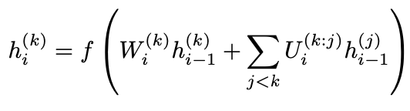
Architecture growing methods
Avoid catastrophic forgetting by extending the network parameters.
Pros: Freezing some weights effectively copes with catastrophic forgetting.
Cons: Scalability.
Progressive Neural Networks (PNN)
Used to learn sequential RL tasks.
Define a new neural network (“column”) per task.
Lateral connections to exploit previous knowledge.
[PSS] Rusu et al., “Progressive Neural Networks”, arXiv 2016

Slide 32
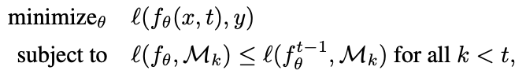
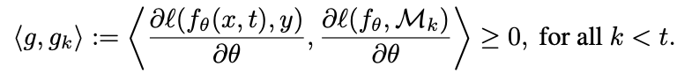
Hybrid approaches
Combining different techniques in tandem.
Gradient Episodic Memory (GEM)
Regularization + Episodic memory
Enforces positive backward transfer, via gradient agreement
Need to solve a QP. Improved in A-GEM.
[GEM] Lopez-Paz and Ranzato, “Gradient Episodic Memory for Continual Learning”, NeurIPS 2017
[A-GEM] Chaudry et al., “Efficient Lifelong Learning with A-GEM”, ICLR 2019

Slide 33
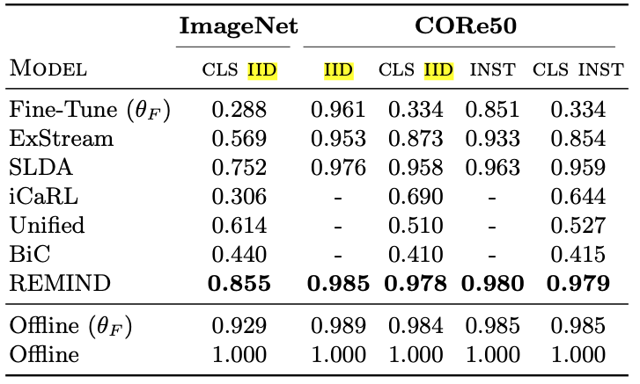
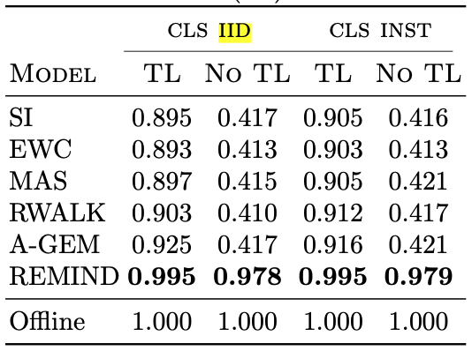
Some results
From REMIND paper
[REMIND] Hayes et al., “REMIND your Network to Prevent Catastrophic Forgetting”, ECCV 2020

Slide 34
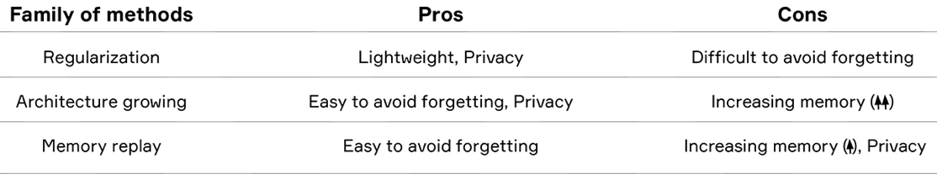
Methods summary…
Volpi R., Larlus D., Rogez G., “The Short Memory of Artificial Neural Networks”, NLE’s blog.

Slide 35
Continual learning @Naver Labs Europe
Worked on continual learning and continual domain adaptation
Volpi et al., “Continual Adaptation of Visual Representations via Domain Randomization and Meta-learning”, CVPR 2021 (Oral)
Volpi et al., “On the Road to Online Adaptation for Semantic Image Segmentation”, CVPR 2022
We have been particularly interested in online/unsupervised domain adaptation.
We have been targeting more challenging computer vision tasks
In particular, we have been focusing a lot on semantic image segmentation.

Slide 36
Online unsupervised domain adaptation
The goal is adapting frame-by-frame to sequences of temporally correlated, unlabeled samples.
Each sample from the sequence ${\left(x_{t}\right)}_{t=1}^{∞} {\sim P}_{t}$ represents an adaptation problem itself.

Slide 37
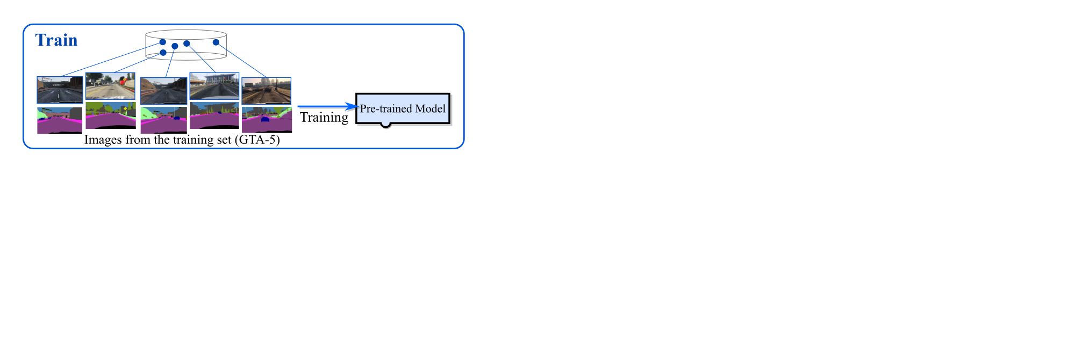


Online unsupervised domain adaptation
The goal is adapting frame-by-frame to sequences of temporally correlated, unlabeled samples.
Each sample from the sequence ${\left(x_{t}\right)}_{t=1}^{∞} {\sim P}_{t}$ represents an adaptation problem itself.
We proposed the OASIS benchmark (Online Adaptation for Semantic Image Segmentation)
[OASIS] Volpi R., De Jorge P., Larlus D. and Csurka G., “On the Road to Online Adaptation for Semantic Image Segmentation”, to appear at CVPR 2022

Slide 38
Online unsupervised domain adaptation
The goal is adapting frame-by-frame to sequences of temporally correlated, unlabeled samples.
Each sample from the sequence ${\left(x_{t}\right)}_{t=1}^{∞} {\sim P}_{t}$ represents an adaptation problem itself.
We proposed the OASIS benchmark (Online Adaptation for Semantic Image Segmentation)
Differences with
(Standard) unsupervised domain adaptation: no access to target(s) distribution(s).
Domain generalization: possibility to adapt/possily store some target samples.
Other continual learning frameworks: unlabelled.
Test-time adaptation: in principle none, but different evaluation/hypotheses.
[OASIS] Volpi R., De Jorge P., Larlus D. and Csurka G., “On the Road to Online Adaptation for Semantic Image Segmentation”, to appear at CVPR 2022

Slide 39

Online unsupervised domain adaptation
The goal is adapting frame-by-frame to sequences of temporally correlated, unlabeled samples.
Each sample from the sequence ${\left(x_{t}\right)}_{t=1}^{∞} {\sim P}_{t}$ represents an adaptation problem itself.
Some methods:
Self-training with pseudo-labels
BN statistics adaptation
BN parameters adaptation
Self-supervised training
[OASIS] Volpi R., De Jorge P., Larlus D. and Csurka G., “On the Road to Online Adaptation for Semantic Image Segmentation”, to appear at CVPR 2022

Slide 40

Online unsupervised domain adaptation
The goal is adapting frame-by-frame to sequences of temporally correlated, unlabeled samples.
Each sample from the sequence ${\left(x_{t}\right)}_{t=1}^{∞} {\sim P}_{t}$ represents an adaptation problem itself.
Some methods:
Self-training with pseudo-labels
BN statistics adaptation
BN parameters adaptation
Self-supervised training
1. Trust (some of) your model’s predictions
2. Use them as ground truth to update your model
3. Repeat
[Lee et al., “Pseudo-label: The Simple and Efficient Semi-supervised Learning Method for Deep Neural Networks” ICMLW 2013]
[OASIS] Volpi R., De Jorge P., Larlus D. and Csurka G., “On the Road to Online Adaptation for Semantic Image Segmentation”, to appear at CVPR 2022

Slide 41


Online unsupervised domain adaptation
The goal is adapting frame-by-frame to sequences of temporally correlated, unlabeled samples.
Each sample from the sequence ${\left(x_{t}\right)}_{t=1}^{∞} {\sim P}_{t}$ represents an adaptation problem itself.
Some methods:
Self-training with pseudo-labels
BN statistics adaptation
BN parameters adaptation
Self-supervised training
[Mancini et al., “Kitting in the Wild through Online Domain Adaptation” IROS 2018]
[Schneider et al., “Improving robustness against common corruptions by covariate shift adaptation”, NeurIPS 2020]
[OASIS] Volpi R., De Jorge P., Larlus D. and Csurka G., “On the Road to Online Adaptation for Semantic Image Segmentation”, to appear at CVPR 2022

Slide 42


Online unsupervised domain adaptation
The goal is adapting frame-by-frame to sequences of temporally correlated, unlabeled samples.
Each sample from the sequence ${\left(x_{t}\right)}_{t=1}^{∞} {\sim P}_{t}$ represents an adaptation problem itself.
Some methods:
Self-training with pseudo-labels
BN statistics adaptation
BN parameters adaptation
Self-supervised training
[Wang et al., “Tent: Fully Test-time Adaptation by Entropy Minimization” ICLR 2021]
[OASIS] Volpi R., De Jorge P., Larlus D. and Csurka G., “On the Road to Online Adaptation for Semantic Image Segmentation”, to appear at CVPR 2022

Slide 43

Online unsupervised domain adaptation
The goal is adapting frame-by-frame to sequences of temporally correlated, unlabeled samples.
Each sample from the sequence ${\left(x_{t}\right)}_{t=1}^{∞} {\sim P}_{t}$ represents an adaptation problem itself.
Some methods:
Self-training with pseudo-labels
BN statistics adaptation
BN parameters adaptation
Self-supervised training
Solve a side SSL objective on the target samples
[Sun et al., “Test-Time Training with Self-Supervision for Generalization under Distribution Shifts” ICML 2020]
[OASIS] Volpi R., De Jorge P., Larlus D. and Csurka G., “On the Road to Online Adaptation for Semantic Image Segmentation”, to appear at CVPR 2022

Slide 44

Online unsupervised domain adaptation
The goal is adapting frame-by-frame to sequences of temporally correlated, unlabeled samples.
Each sample from the sequence ${\left(x_{t}\right)}_{t=1}^{∞} {\sim P}_{t}$ represents an adaptation problem itself.
Some methods:
Self-training with pseudo-labels
BN statistics adaptation
BN parameters adaptation
Self-supervised training
“Test-time adaptation” is becoming an active research field, with different methods published ~monthly
Mostly for robustness against corruptions, but all these methods can be used by a continual learner
[OASIS] Volpi R., De Jorge P., Larlus D. and Csurka G., “On the Road to Online Adaptation for Semantic Image Segmentation”, to appear at CVPR 2022

Slide 45

Online unsupervised domain adaptation
The goal is adapting frame-by-frame to sequences of temporally correlated, unlabeled samples.
Each sample from the sequence ${\left(x_{t}\right)}_{t=1}^{∞} {\sim P}_{t}$ represents an adaptation problem itself.
Some methods:
Self-training with pseudo-labels
BN statistics adaptation
BN parameters adaptation
Self-supervised training
“Test-time adaptation” is becoming an active research field, with different methods published ~monthly
Mostly for robustness against corruptions, but all these methods can be used by a continual learner
Similar formulations studied for 3D depth estimation
[Tonioni et al., “Real-time Self-adaptive Deep Stereo”, CVPR 2019]
[Poggi et al., “Continual Adaptation for Deep Stereo”, TPAMI 2021]
[OASIS] Volpi R., De Jorge P., Larlus D. and Csurka G., “On the Road to Online Adaptation for Semantic Image Segmentation”, to appear at CVPR 2022

Slide 46

Online unsupervised domain adaptation
The goal is adapting frame-by-frame to sequences of temporally correlated, unlabeled samples.
Each sample from the sequence ${\left(x_{t}\right)}_{t=1}^{∞} {\sim P}_{t}$ represents an adaptation problem itself.
Main problem: also here, catastrophic forgetting!
We’re learning in an unsupervised way, so it’s not trivial how to avoid the model to forget classes.
In practical terms, classes that are more rare will disappear, leaving their space to the more abundant ones.
Example: if we’re adapting a segmentation model for urban street segmentation, it’s very easy to forget about things (countable objects), overtaken by the more abundant stuff (street, sky, buildings, etc.)
[OASIS] Volpi R., De Jorge P., Larlus D. and Csurka G., “On the Road to Online Adaptation for Semantic Image Segmentation”, to appear at CVPR 2022

Slide 47

Online unsupervised domain adaptation
The goal is adapting frame-by-frame to sequences of temporally correlated, unlabeled samples.
Each sample from the sequence ${\left(x_{t}\right)}_{t=1}^{∞} {\sim P}_{t}$ represents an adaptation problem itself.
Main problem: also here, catastrophic forgetting!
We’re learning in an unsupervised way, so it’s not trivial how to avoid the model to forget classes.
In practical terms, classes that are more rare will disappear, leaving their space to the more abundant ones.
Some solutions:
“Naive” learning: instead of doing continual learning, at each frame re-start from the original model.
Memories: keep rehearsing the original (labelled) training samples to the model.
Reset strategies: use the original model as a checkpoint, and reset when some thershold is met.
[OASIS] Volpi R., De Jorge P., Larlus D. and Csurka G., “On the Road to Online Adaptation for Semantic Image Segmentation”, to appear at CVPR 2022

Slide 48


Online unsupervised domain adaptation
The goal is adapting frame-by-frame to sequences of temporally correlated, unlabeled samples.
Each sample from the sequence ${\left(x_{t}\right)}_{t=1}^{∞} {\sim P}_{t}$ represents an adaptation problem itself.
We don’t care about performance on previous tasks here: it’s a continuous stream, and we only care about the present.
[OASIS] Volpi R., De Jorge P., Larlus D. and Csurka G., “On the Road to Online Adaptation for Semantic Image Segmentation”, to appear at CVPR 2022

Slide 49

Online unsupervised domain adaptation
Some results…
Code available at
github.com/naver/oasis
[OASIS] Volpi R., De Jorge P., Larlus D. and Csurka G., “On the Road to Online Adaptation for Semantic Image Segmentation”, to appear at CVPR 2022

Slide 50


Online unsupervised domain adaptation
The goal is adapting frame-by-frame to sequences of temporally correlated, unlabeled samples.
Each sample from the sequence ${\left(x_{t}\right)}_{t=1}^{∞} {\sim P}_{t}$ represents an adaptation problem itself.
Some results…
[OASIS] Volpi R., De Jorge P., Larlus D. and Csurka G., “On the Road to Online Adaptation for Semantic Image Segmentation”, to appear at CVPR 2022

Slide 51
Wrapping-up…
Many formulations and family of methods to start from in continual learning.
The main issue that the community is focusing on is still catastrophic forgetting.
Methods that use episodic memories perform better by large margins. Yet, trade-offs with memory overheads and privacy issues.
We have found several CL sub-problems that are interesting within the computer vision sphere.
(image from Shutterstock)
We don’t plan to stop researching on CL any soon, feel free to reach out about this ;-)

Slide 52








Acknowledgments
Cesar de Souza
Diane Larlus
Gabriela Csurka
Grégory Rogez
Yannis Kalantidis
Pau de Jorge
(image from Shutterstock)

